Slide 1
Turning C into Object Code
  Code in files p1.c p2.c
  Compile with command: gcc p1.c p2.c -o p
    Put resulting binary in file p
text
C program (p1.c p2.c)
Compiler (gcc –Og -S)
text
Asm program (p1.s p2.s)
Assembler (gcc or as)
binary
Object program (p1.o p2.o)
Static libraries (.a)
Linker (gcc or ld)
binary
Executable program (p)

Slide 2
Compiling Into Assembly
C Code (sum.c)
Generated x86-64 Assembly
long plus(long x, long y);
void sumstore(long x, long y,
long *dest)
{
long t = plus(x, y);
*dest = t;
}
sumstore:
pushq %rbx
movq %rdx, %rbx
call plus
movq %rax, (%rbx)
popq %rbx
ret
Obtain with command
  gcc –S sum.c
Produces file sum.s

Slide 3
Object Code
Code for sumstore
Assembler
  Translates .s into .o
  Binary encoding of each instruction
  Nearly-complete image of executable code
  Missing linkages between code in different files
Linker
  Resolves references between files
  Combines with static run-time libraries
    E.g., code for malloc, printf
  Some libraries are dynamically linked
    Linking occurs when program begins execution
0x0400595:
0x53
0x48
0x89
0xd3
0xe8
0xf2
0xff
0xff
0xff
0x48
0x89
0x03
0x5b
0xc3
  Total of 14 bytes
  Each instruction 1, 3, or 5 bytes
  Starts at address 0x0400595

Slide 4
Machine Instruction Example
C Code
  Store value t where designated by dest
Assembly
  Move 8-byte value to memory
    Quad words in x86-64 parlance
  Operands:
    t: Register %rax
    dest: Register %rbx
    *dest: Memory M[%rbx]
Object Code
  3-byte instruction
  Stored at address 0x40059e
*dest = t;
movq %rax, (%rbx)
0x40059e: 48 89 03

Slide 5
Disassembling Object Code
Disassembled
0000000000400595 <sumstore>:
400595: 53 push %rbx
400596: 48 89 d3 mov %rdx,%rbx
400599: e8 f2 ff ff ff callq 400590 <plus>
40059e: 48 89 03 mov %rax,(%rbx)
4005a1: 5b pop %rbx
4005a2: c3 retq
Disassembler
  objdump –d sum
  Useful tool for examining object code
  Analyzes bit pattern of series of instructions
  Produces approximate rendition of assembly code
  Can be run on either a.out (complete executable) or .o file

Slide 6
Alternate Disassembly
Disassembled
Object
0x0400595:
0x53
0x48
0x89
0xd3
0xe8
0xf2
0xff
0xff
0xff
0x48
0x89
0x03
0x5b
0xc3
Dump of assembler code for function sumstore:
0x0000000000400595 <+0>: push %rbx
0x0000000000400596 <+1>: mov %rdx,%rbx
0x0000000000400599 <+4>: callq 0x400590 <plus>
0x000000000040059e <+9>: mov %rax,(%rbx)
0x00000000004005a1 <+12>:pop %rbx
0x00000000004005a2 <+13>:retq
Within gdb Debugger
  gdb sum
  disassemble sumstore
  Disassemble procedure
  x/14xb sumstore
  Examine the 14 bytes starting at sumstore

Slide 7
What Can be Disassembled?
% objdump -d WINWORD.EXE
WINWORD.EXE: file format pei-i386
No symbols in "WINWORD.EXE".
Disassembly of section .text:
30001000 <.text>:
30001000: 55 push %ebp
30001001: 8b ec mov %esp,%ebp
30001003: 6a ff push $0xffffffff
30001005: 68 90 10 00 30 push $0x30001090
3000100a: 68 91 dc 4c 30 push $0x304cdc91
Reverse engineering forbidden by
Microsoft End User License Agreement
Anything that can be interpreted as executable code
Disassembler examines bytes and reconstructs assembly source

Slide 8
Binary Bomb project -phases
Worth twice the points of HW3 or HW4
Six problems (phases)
  Phase 1: text comparison
  Phase 2: loops
  Phase 3: conditionals/switches
  Phase 4: recursive calls and the stack discipline
  Phase 5: pointers
  Phase 6: linked lists/pointers/structs
A secret phase does NOT get credits

Slide 9
Binary Bomb project – src code
Download a bomb from http://mercury.cs.uml.edu:15213 to your laptop (use your CS account email address)
  Unless you have a VPN to UML, you cannot download from outside of UML
From your laptop, file transfer bombxxx.tar to mercury.cs.uml.edu (with Winscp or FileZilla for file transfer)
Log in to mercury.cs.uml.edu (with putty or ssh)
  Uncompress bombxxx.tar
  In bombxxx directory, get the x86 source code
    objdump –d bomb > bomb.txt
    File transfer bomb.txt to your laptop, and study assembly codes in bomb.txt

Slide 10
Binary Bomb project - gdb
Add comments to bomb.txt in pseudo-C style
  Figure out where to place breakpoints for individual phases
Google search gdb
  Tons of tutorials, and command helps
In mercury,
  Start gdb
    gdb bomb
  Set breakpoints
    Examine data in memory appropriate for the phase

Slide 11
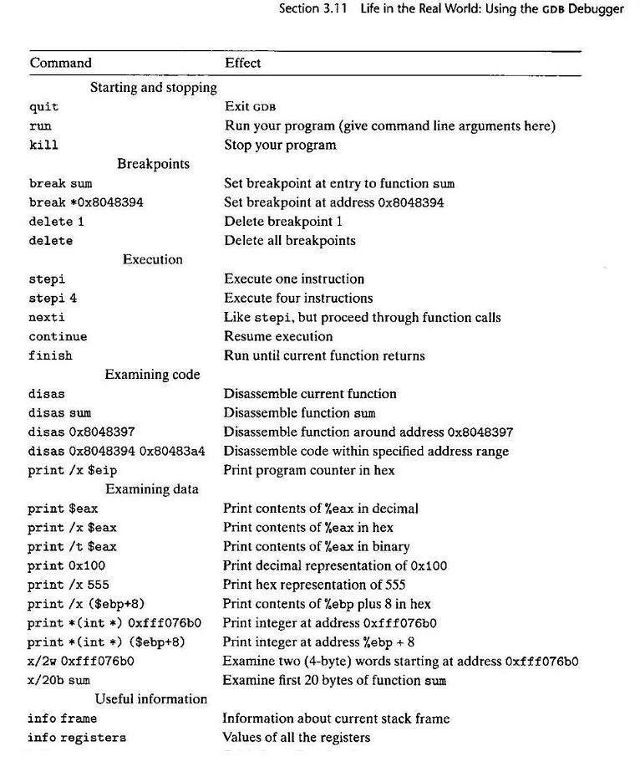

Slide 12
x/20c sum Examine first 20 characters of sum
x/x 0xfff076b0 Print in hex a word at address 0xfff076b0

